Slide 1

Magic: The Gathering
a framework for exploring meta

Slide 2
Background
Tournament prizes of $35,000 for Grand Prix events
Cards themselves are relatively expensive
Large sample size of possible cards
Each competitor uses a set of 60+15 cards
Identifying reasons for playing specific sets of cards is challenging

Slide 3
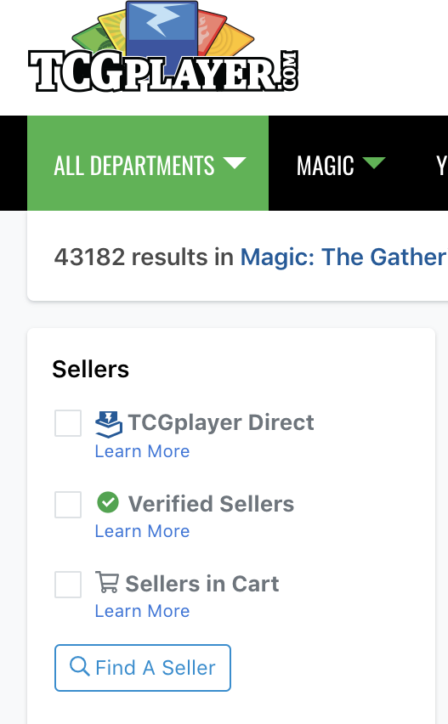
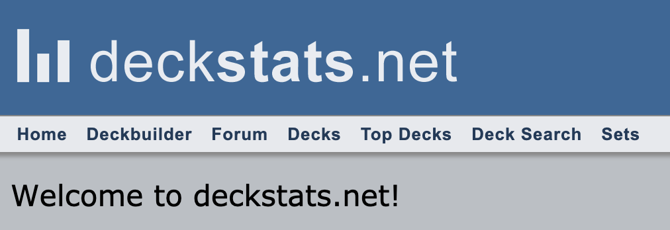
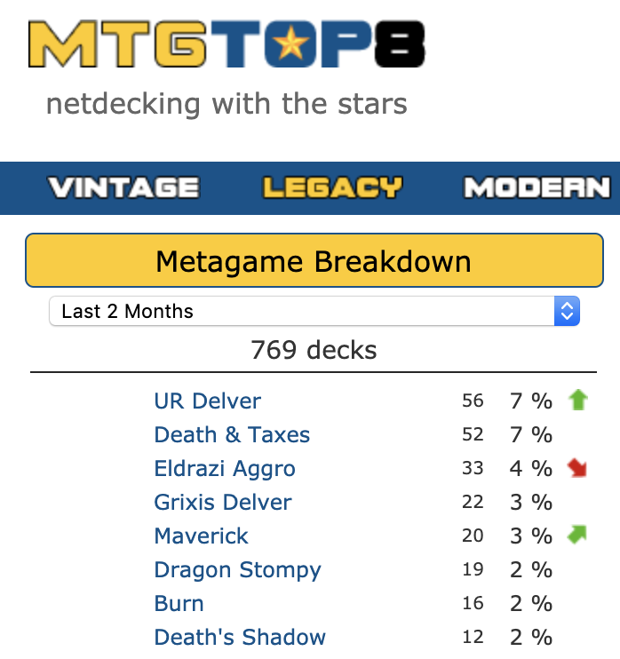
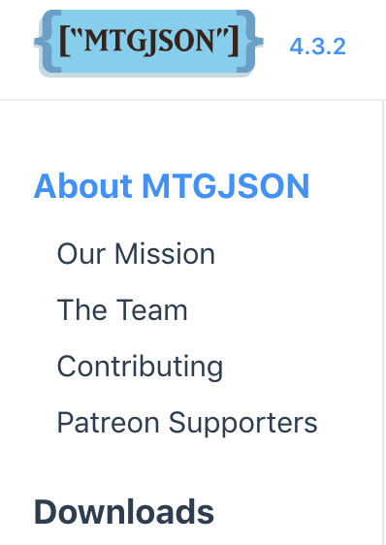
Data Used
Tcgplayer.com: Pricing data through API
Mtgjson.com: Card details
Mtgtop8.com: Tournament Entrants and results
Deckstats.net: Card Data Storage

Slide 4
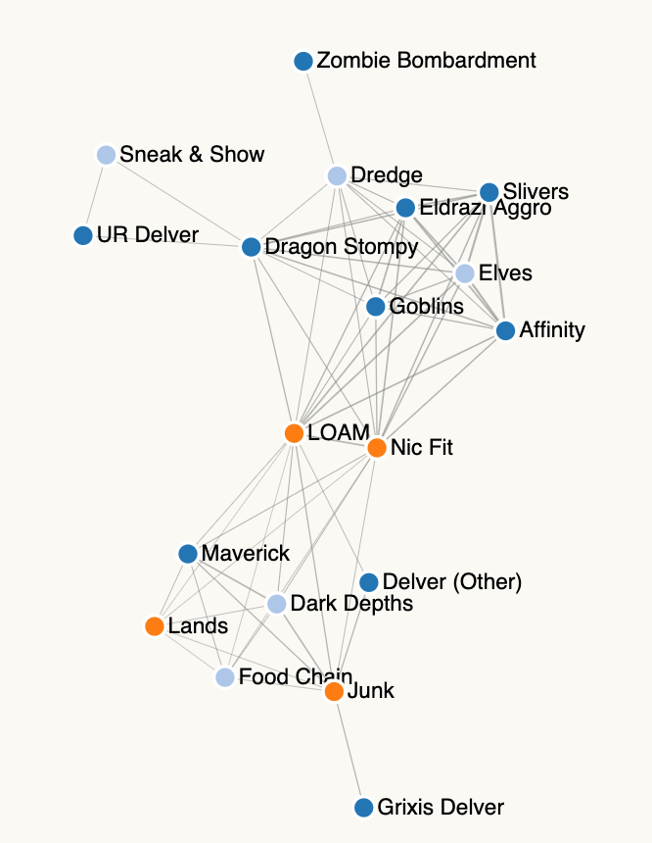
Methodology
Data Gathering
Python API wrapper for tcgplayer
Manual data gathering from mtgtop8
Data Exploration using force directed graphs
Jaccard’s Similarity
Filtering by price and card type
Color by deck type

Slide 5
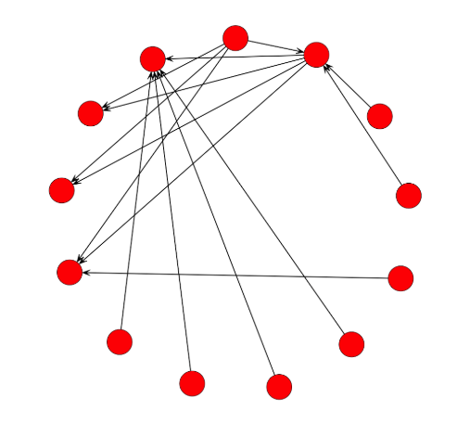
Next Steps
Use radial graph with interactivity through single-page filtering
Implement Transitions
Highlight decks with click
Tooltip showing transition costs to other decks

Slide 6
Future additions
Include win/loss data
Include player quantities with deck data
Compile over time to study meta topology
Deal with computational expense of cost filtering

